Slide 1
Data Product Manager Nanodegree
Applying Data Science to Product Management
Final Project: Developing an MVP Launch Strategy for a Flying Taxi Service

Slide 2


Slide 3
In this project, I applied the skills as Data Product Manager to create the MVP launch strategy for the first flying car taxi service, Flyber, in one of the most congested cities in America -- New York City.
I was responsible for bringing the first flying car taxi service to market by analyzing data and building a product proposal.
Introduction

Slide 4
Section 1: Data Exploration

Slide 5
Understanding our customers and their pain points:
What are taxis used for?
What are the characteristics of the users that leverage them?
What are existing pain points with taxis?
What are the existing pain points with digital ride-sharing services?

Slide 6
Our customers and their pain points:
What are the taxis used for?
According to the data provided, taxis are typically used to cover short distances, with an average distance traveled of 3.442. The map visualization analyzing the main passenger pick-up locations revealed that taxis are heavily used to travel around Midtown Manhattan, Murray Hill, Garment District, and Columbus Circle. Using the zoom feature, it was possible to observe that there's a high demand at spots like Port Authority Bus Terminal, Penn Station, NY Penn Station, and Grand Central Terminal.
Geospatial Data Analysis at Tableau - Pick-Up Location
The drop-off locations remain concentrated in similar places. Using the zoom feature, it's notable that rides are often used to go to areas near TCI College of Technology.
Geospatial Data Analysis at Tableau – Drop-off Location
It was also observed that taxis are used for nighttime rides, with the peak number of rides occurring at 6pm and maintaining high numbers until 11pm.
Line Graph at Tableau – Rides per hour

Slide 7
What are the characteristics of the users that leverage them?
According to the data provided, the average age of taxi users is 47 years old, and they identify as female.
Taxi users typically travel alone, or with, at most, one other person, given that the average number of passengers per trip is 1.66.
Most passengers earn between $40,000 and $80,000 and reside in Midtown, Battery Park, and Tribeca.
Distribution Analysis at Tableau – Neighborhoods of Residence
Bar Chart at Tableau – Income
Our customers and their pain points:

Slide 8
What are existing pain points with taxis?
The data analysis and calculations allowed us to conclude that the problem faced by taxis is that they take a long time to cover short distances. The average distance per ride is 3.442, and the average time is 962.2, just over 16 minutes.
What are the existing pain points with digital ride-sharing services?
There is a difference in passenger adoption between taxis and digital ride-sharing services: the number of passengers using taxis is more significant compared to those who claim to use ride-sharing currently. In other words, the taxi service is more accepted and is the preferred choice of users.
Pie Chart at Tableau – Taxi Usage
Pie Chart at Tableau – Rideshare Usage
Our customers and their pain points:

Slide 9
Product Hypothesis
What user improvements do you hypothesize a flying taxi service would have over the existing state of taxis today?
What market improvements do you hypothesize a flying taxi service would have the existing taxi service industry & physical road infrastructure today?

Slide 10
Product Hypothesis
What user improvements do you hypothesize a flying taxi service would have over the existing state of taxis today?
I believe the flying service can help passengers travel more quickly and easily through the city's most congested areas, saving time and, consequently, money. For taxi drivers, the proposal is appealing: Being able to avoid traffic jams, they can make more trips and increase their income. Added to this is the reduction in stress levels experienced by passengers and, especially, drivers who are forced to face intense traffic conditions daily.
What market improvements do you hypothesize a flying taxi service would have the existing taxi service industry & physical road infrastructure today?
Over time, with a reduction in road traffic, there might be decreased wear and tear on road infrastructures. This could reduce the frequency and cost of road repairs. Besides, flying taxis could potentially make remote areas more accessible, as they wouldn't be restricted by the absence of roads. We can also consider the possibility to locations with nearby flying taxi ports might see an increase in land value due to increased accessibility. This could also affect urban development patterns.

Slide 11
Data Analysis
Acquiring a high-level understanding of the granularity and scope of the dataset to inform the basis for data analyses:
How many records are in the dataset?
What does each record represent?
What is the primary key?
What date range is your dataset bound to?
What are the geographical bounds of this dataset? Is it limited to Manhattan, or is Brooklyn, Queens, Staten Island, the Bronx, and New Jersey included? Where are most of the data points centralized at? Are there outliers?

Slide 12
Data Analysis
How many records are in the dataset?
The dataset loaded into Tableau has 1,048,468 records.
What does each record represent?
These records represent data on latitude, longitude, date and time of pick-up and drop-off, as well as data on the distance and duration of the rides. It's also possible to find values about the number of passengers transported on each trip, data to identify the ride and vendor, as well as information regarding the store and forward flag system.
What is the primary key?
The "id" column is the primary key.
What date range is your dataset bound to?
The data available in the dataset ranges from January 1, 2016, to June 30 of the same year.
What are the geographical bounds of this dataset? Is it limited to Manhattan, or is Brooklyn, Queens, Staten Island, the Bronx, and New Jersey included? Where are most of the data points centralized at? Are there outliers?
The data is predominantly about the use of taxis in Manhattan, from the Financial District to Central Park. The outliers are JFK airport and LGA airport.

Slide 13
Data Analysis
Let’s understand the scope and distribution various dimensions within the dataset and show the average, median, and the first & second standard deviation of the mean for the following measures:
duration
distance
passenger counts
duration-to-distance ratio
price

Slide 14
Data Analysis
  Duration - Seconds average - 962 median - 662 first standard - 5853 second standard - 11706
  Distance - Miles average – 3,442 median – 2,095 first standard – 4,382 second standard – 8,764
  Passenger count average – 1,6644 median – 1,000 first standard – 1,3142 second standard – 2,6284
  Duration-to-distance Miles/Sec average – 498,6 median – 286,3 first standard – 3982 second standard – 7964
  Price average – $15.29 median – $10.84 first standard – $27.75 second standard – $55.50

Slide 15
Strategy for Flyber MVP
For the initial MVP launch, we have a finite amount of monetary resources to build Flyber pick-up / drop-off nodes. We’ll need to be strategic on where we’ll place them. So, our proposal considers:
Which neighborhoods/zip codes tends to experience a relatively higher density of pick-ups?
Which neighborhoods/zip codes tends to experience a relatively higher density of drop-offs?
Which neighborhoods/zip codes tends to have the highest duration-to-distance ratios, based on pick-up?
Which neighborhoods/zip codes tends to have the highest duration-to-distance ratios, based on drop-off?
For any of the neighborhoods identified, are there any potential areas within the neighborhood that are optimal for flying taxi pick-up / drop-off? What makes them suitable?

Slide 16
Flyber MVP
Which neighborhoods/zip codes tends to experience a relatively higher density of pick-ups?
The neighborhood with the highest density of pick-ups is Midtown Manhattan, specifically around Madison Square Garden and NY Penn Station. Other notable spots in Midtown include the area near the Garment District and the Grand Central Terminal. Additionally, there are also a significant number of pick-ups at Columbus Circle.
Which neighborhoods/zip codes tends to experience a relatively higher density of drop-offs?
The neighborhood with the highest density of drop-offs is Midtown Manhattan, specifically around Madison Square Garden and NY Penn Station, as well as the Grand Central Terminal region and Port Authority Bus Terminal, also in Midtown.
Which neighborhoods/zip codes tends to have the highest duration-to-distance ratios, based on pick-up?
It continues to be the Midtown neighborhood around Madison Square Garden and NY Penn Station, Port Authority Bus Terminal, and the Grand Central Terminal.
Geospatial Data Analysis at Tableau – Ratio Pick-Up
Which neighborhoods/zip codes tends to have the highest duration-to-distance ratios, based on drop-off?
Midtown Manhattan around Madison Square Garden and NY Penn Station.
Geospatial Data Analysis at Tableau – Ratio Drop-Off
For any of the neighborhoods identified, are there any potential areas within the neighborhood that are optimal for flying taxi pick-up / drop-off? What makes them suitable?
The potential areas are the regions around NY Penn Station and Grand Central Terminal. Being major transportation hubs, they might potentially offer conditions for flying taxi pick-up/drop-off.

Slide 17
Strategy for Flyber MVP
It may not make operational sense to have the service running 24/7, for now.
What times throughout the day experience relatively higher volumes of ride pick-ups?
What days throughout the week experience relatively higher volumes of ride pick-ups?
It’s important also pinpoint any periods throughout the year that experience trend fluctuation or seasonality around ride pick-up volumes. This will help us in our post-launch analyses to determine if any spikes or dips were influenced by seasonality or through actual feature adoption/regression.

Slide 18
Flyber MVP
What times throughout the day experience relatively higher volumes of ride pick-ups?
Starting from 4pm, the number of pick-ups begins to increase, peaking at 6pm and remaining high throughout the night, decreasing from midnight onwards.
What days throughout the week experience relatively higher volumes of ride pick-ups?
The days with the highest volume of pick-ups are Thursdays, Fridays, and Saturdays.
Bar Chart at Tableau – Days of the Week - Pick-ups
Periods throughout the year that experience trend fluctuation or seasonality around ride pick-up volumes. This will help us in our post-launch analyses to determine if any spikes or dips were influenced by seasonality or through actual feature adoption/regression.
A sharp decline in taxi rides occurred in January 2016, specifically on the 23rd due to the "Winter Storm Jonas" (January 2016 United States Blizzard). In May, there was a drop, though less pronounced, on the 30th, which was Memorial Day Monday.
Line Graph at Tableau – Trend Fluctuation

Slide 19
User Research
The user research team ran a quantitative survey on existing taxi and/or rideshare users in New York City to determine sentiment around potentially using a flying taxi service.
As Data Product Manager, I have dived into the survey results dataset to extract insights from explicit feedback and to inform our future product marketing efforts.
I have extracted the following:
- Is there an inclination of better Flyber adoption based on gender, age, income level, or neighborhood of residence?
- What is the distribution of potential price per mile based on gender, age, income level, and neighborhood of residence?
- What is the different personas/segments of negative sentiment towards not using a flying taxi car service?

Slide 20
User Research
Is there an inclination of better Flyber adoption based on gender, age, income level, or neighborhood of residence?
Yes, women have a higher level of affirmative responses for the flying taxi service. The age group with the most acceptance is around 27 years old. Users who most often said they would use the service earn between $40,000 and $80,000 and live in the neighborhoods of Midtown, Battery Park District, and Financial District.
Dashboard at Tableau – Flying Taxi Adoption
What is the distribution of potential price per mile based on gender, age, income level, and neighborhood of residence?
There isn't a significant variation in average price based on gender: females would pay an average of $23.28, while males would pay $23.01. In terms of age, the group willing to pay the highest average price ($30.00) is those aged 30, while those aged 49 are the least willing, offering $15.44 on average.
It was also observed that people with higher incomes would be willing to pay more for the rides.
Residents from the neighborhoods of Inwood, Financial District, Bowery, and Battery Park stand out as those who would consider paying higher average prices for rides with the flying taxi.
Dashboard at Tableau – Price
What is the different personas/segments of negative sentiment towards not using a flying taxi car service?
Based on the observed data, individuals who identified as male tend to have more negative feelings towards the flying taxi than those who identified as female. Those expressing the most negative sentiments are, on average, between 50 and 55 years old. The main concern raised pertains to safety: various responses (such as "I think it’s more unsafe than taxis", "I think it’s more dangerous", "It’s dangerous", "It’s unsafe", and "I wouldn’t trust the person flying it") highlighted issues of safety and trust.

Slide 21
Section 2: Proposal Synthesis

Slide 22
User Acquisition
Strategy
Promote the use of Flyber by offering a 50% discount to those who download the app and request the service within the first seven days.
Explanation
I believe that focusing on User Acquisition is appropriate for this stage of product development because it is an innovative service, and it is crucial to educate the audience about the benefits, the operation of the service, and, most importantly, about safety. The need to build trust and credibility became evident through user surveys, which highlighted safety concerns as the primary reason for doubts about Flyber. The response 'I think it is more unsafe than taxis' was the main reason cited for rejecting a flying taxi service.
Distribution Analysis at Tableau – Rejection Reasons
Thus, the discount on the first ride can encourage the use of the flying taxi while reducing safety concerns, as users will gain practical experience.

Slide 23
KPI
KPIs for Q1
- Discount to paid conversion rate of 10% on average, considering surveys that position the brand positively for an app-based service.
- Net Promoter Score in the industry average, around 23 (considering values from -100 to 100, with scores above 0 considered good and above 50 considered excellent).
- An increase in the number of users by 8% in the quarter, considering that app-based transportation services grow, on average, by 11% in the quarter.
It's important to note that the data presented here are based on information available online from app-based transportation companies. You can verify the information on the following websites: https://userpilot.com/blog/free-to-paid-conversion-strategy https://customer.guru/net-promoter-score/uber https://www.businessofapps.com/data/uber-statistics/ https://www.statista.com/statistics/946298/uber-ridership-worldwide/
The project used these data as a basis for Key Performance Indicators (KPIs) because the previously provided data (user_research and taxi_rides) were not sufficient to estimate the KPIs.

Slide 24
Go-To-Market Plan
Based on the insights I have extracted, suggestions about the go-to-market strategy considered the following:
What times/days of operation should the service run for?
How many pick-up / drop-off nodes should we have?
Where should the nodes be located?
Should we initially use copters or homegrown hardware?
Should the pricing be fixed or dynamic? At what rates?

Slide 25
Go-To-Market
What times/days of operation should the service run for?
It should be initially offered on the days that have been identified as having the highest demand for taxis, namely Thursdays, Fridays, and Saturdays, thereby increasing the likelihood of service adoption.
How many pick-up / drop-off nodes should we have?
It would be advisable to have two points initially, considering the need to keep operational expenses in check.
Where should the nodes be located?
The two locations would be NY Penn Station and Grand Central Terminal. The choice is justified as both locations were identified in the data analysis as the areas with the highest pick-up/drop-off nodes. Additionally, the area can provide the necessary structural conditions, as they are transportation hubs.
Should we initially use copters or homegrown hardware?
It would be advisable to initially use pre-existing options, especially if they utilize hybrid technology, which combines traditional with innovative technologies, such as Vertical Takeoff and Landing (VTOL) electric vehicles. This option is justified by the time and money required for research, development, and regulation for homegrown hardware.
Should the pricing be fixed or dynamic? At what rates?
The pricing could be dynamic, subject to change based on the time of day, with higher prices during peak hours. The pricing should fall within what the research has revealed that prospective customers would be willing to pay, which, according to the analyzed data, is an average of $30 - $50.

Slide 26
MVP Sample Size and Time Period
The sample size will be 139 trips in three months.
This number was obtained using the following formula: n = (Z^2 * p * (1-p)) / E^2 n: Required sample size.
Z: Critical value of the desired confidence level (e.g., 1.96 for a 95% confidence level). p: Estimated conversion rate (0.10 for 10%).
E: Desired margin of error (0.05 for 5%).
So, it would require approximately 139 samples for your flying taxi MVP with a 10% conversion rate to achieve a 95% confidence level and a 5% margin of error.
The time of a quarter was chosen considering that it is necessary to gather short-term data to assess the initial performance of your MVP and collect feedback quickly, the MVP is still in development and subject to significant changes, so a three-month test may be sufficient to identify initial issues and validate concepts and a longer test will require more financial and personnel resources compared to a three-month test.

Slide 27
Instrumentation Plan
This instrumentation plan shows the events we need to collected to be able to measure our KPIs.
a) userRegistration
user_mobile
user_name
user_e-mail
b) userLogin
login_date
login_time
c) userBooking
booking_from
booking_to
booking_price
d) bookingSubmited
e) billingInformation
f) travelOrdered
travel_pickup
travel_dropoff
travel_duration
g) travelRatting

Slide 28
Feedback Survey
To obtain qualitative and explicit feedback, Flyber users should receive, after the ride, directly in the app:
- Possibility to rate the ride with stars (1 to 5).
- Possibility to rate the pilot with stars (1 to 5).
- Answer a yes or no questionnaire for two questions:
1) Would you recommend Flyber?
2) Would you use Flyber again?

Slide 29
Feedback Survey

Slide 30
Final Proposal
Scenario
Downtown New York City can be considered one of the busiest places in the world.
As a result, taxis often encounter heavy traffic, taking a long time to cover short distances.
Data shows that, on average, taxi rides take more than 16 minutes to cover just over 3 miles.
Our Solution
Offering a flying taxi service that can facilitate transportation, enabling time savings and reducing traffic congestion.
Additionally, the service may also, in the long run, result in cost savings in terms of road and highway maintenance due to reduced car circulation.
The service will be provided through the collaboration of various sectors, including developers, data engineers, marketing, and other stakeholders such as partners for the use of copters and local infrastructure providers.

Slide 31
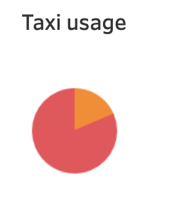

Target Population
User Research Insights
Taxis are a very popular services

Slide 32
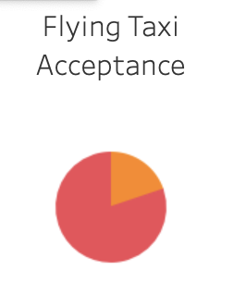
Target Population
User Research Insights
In the case of a flying taxi service, the acceptance is widespread

Slide 33
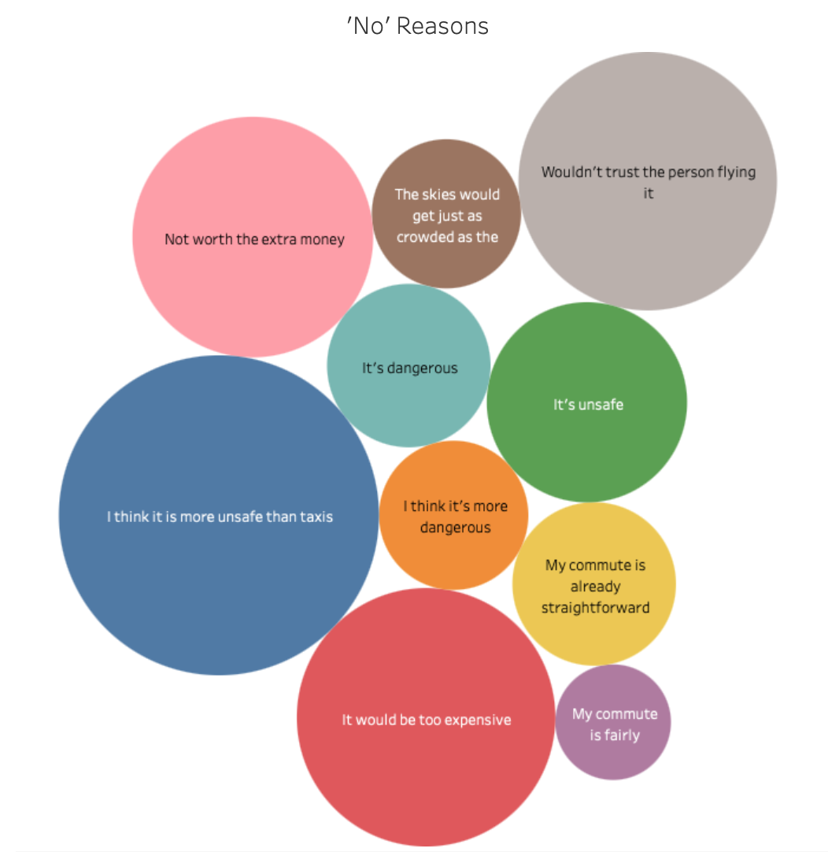
Flyber Acceptance
Challenges
Flyber needs to gain the trust of customers, especially concerning safety, as among those who rejected the service, insecurity was the most frequently cited point.

Slide 34
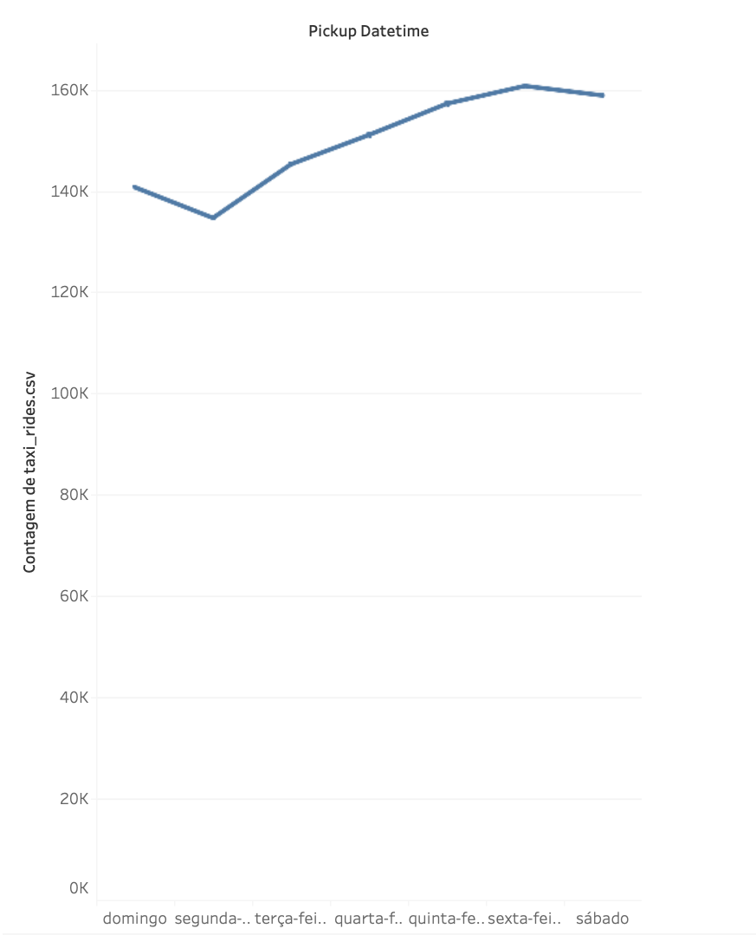
Strategy
First Steps
Developing a successful customer relationship:
App download and discount on the first ride
Test of the service on peak days - Thursdays, Fridays, and Saturdays

Slide 35
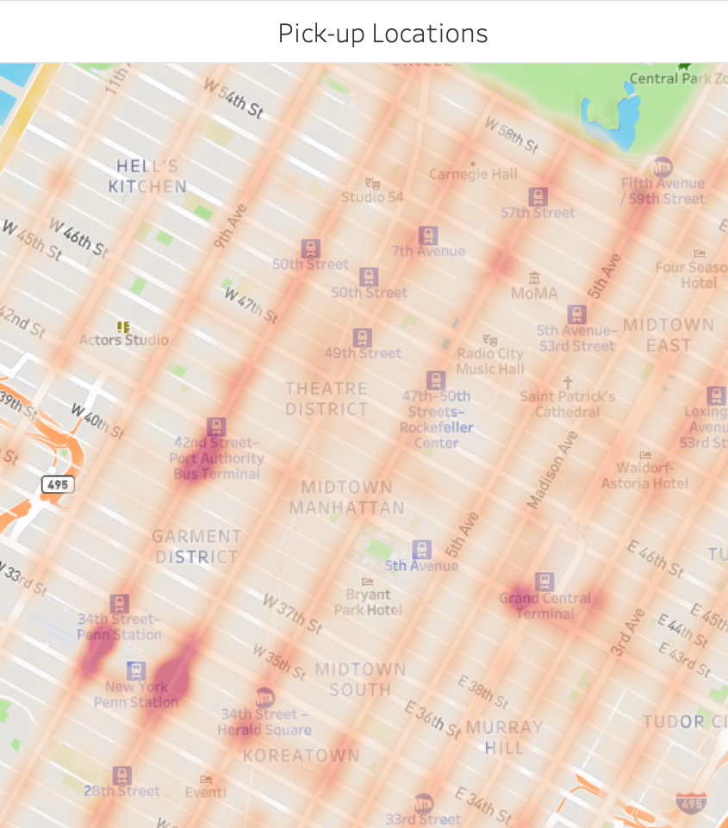
Strategy
First Steps
Points of operation in major transportation hubs - NY Penn Station and Grand Central Terminal

Slide 36
Thank you!

